Slide 1
Data Analytics
Deepak Gangadharan
Assistant Professor, IIIT Hyderabad
Intro to IoT (Spring 2022)

Slide 2
Motivation
Need to derive value out of the data collected by IoT nodes – Analytics is the key!
Collected data usually transformed into dashboards, reports, visualizations and alerts.
Use cases where this is helpful
Monitoring status of connected devices
Presenting device readings in a human-friendly way
Identifying patterns
Detecting anomalies
Trigger actions based on rules
Predict outcomes
Intro to IoT (Spring 2022)

Slide 3
Motivation
Value of IoT lies in the interpretation and decision made of the vast amounts of data.
Data Analytics provides us with the valuable patterns within the data.
Deals with structured data (SQL storage), unstructured data (raw video data) and semi-structured data (twitter feeds).
Data may need to be interpreted and analyzed in real time or may be archived and retrieved for deep analytics in the cloud
Intro to IoT (Spring 2022)

Slide 4
What is Data Handling?
Process of ensuring that research data is stored, archived or disposed off in a safe and secure manner during and after the conclusion of a project
Recently, most data in IoT is Big Data
Due to heavy traffic generated by IoT devices
Huge amount of data generated by sensors
Intro to IoT (Spring 2022)

Slide 5
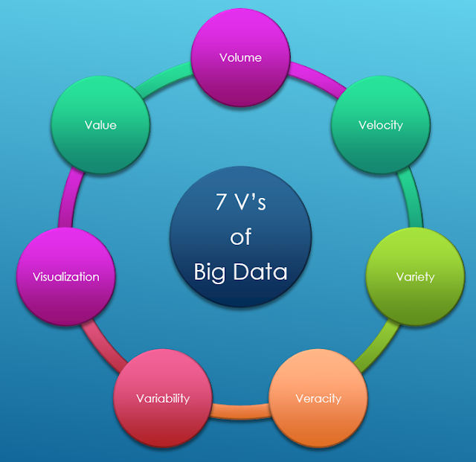
Characteristics of Big Data
Source: http://blogsofdatawarehousing.blogspot.com/2017/01/7-vs-of-big-data.html
Intro to IoT (Spring 2022)

Slide 6
Characteristics of Big Data
Volume
Quantity of data that is generated
Sources of data are added continuously
Velocity
Speed of generation of data
More and more real-time services making data processing complex with high velocity
Older batch processing not useful with high velocity
Variety
Refers to different forms of data sources
Data mostly unstructured or semi-structured
Example of variety: Pure text, images, video, audio, GPS data, sensor data, SMS, documents, etc
Intro to IoT (Spring 2022)

Slide 7
Characteristics of Big Data
Veracity
Refers to biases, noise and abnormality in data
Signifies how accurate or truthful a data set is
Important in programs that make automated decisions
Variability
Meaning of the data depends on the context
Mostly required when working on Natural Language Processing
Visualization
Presentation of data in a graphical or visual format
Enables decision makers to easily interpret the information from analytics
Identify new patterns
Value
Ability to extract useful information to enhance the business value
Intro to IoT (Spring 2022)

Slide 8
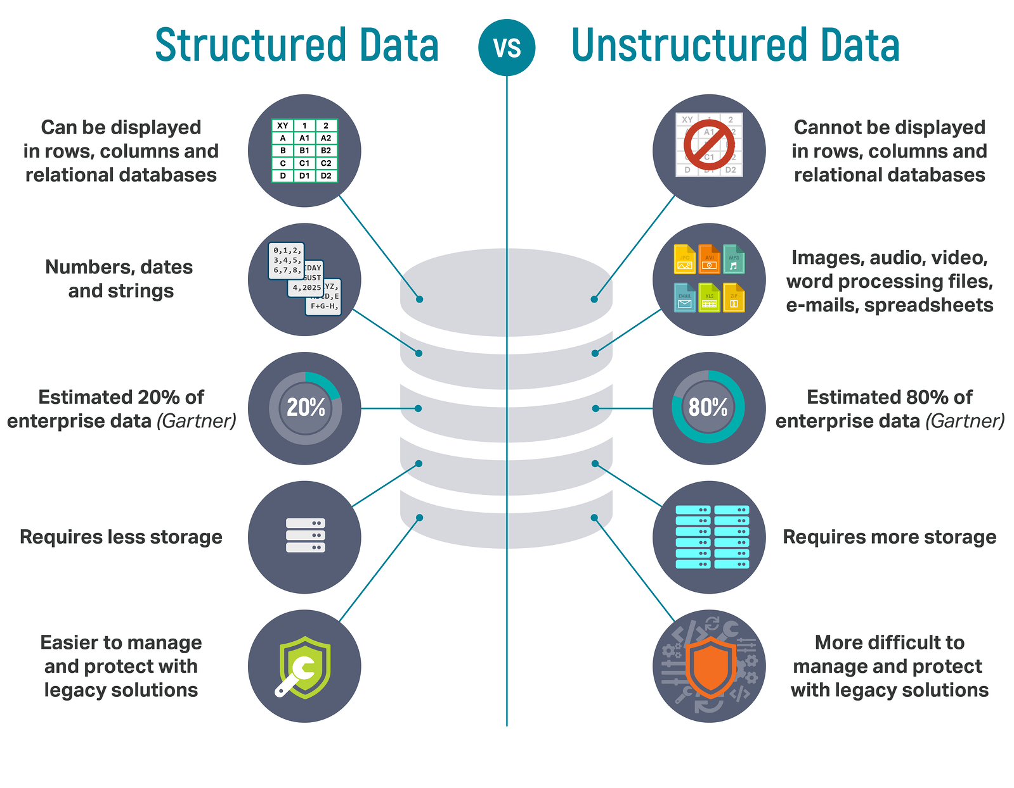
Data Types
Source: https://lawtomated.com/structured-data-vs-unstructured-data-what-are-they-and-why-care/
Intro to IoT (Spring 2022)

Slide 9
Data Flow
Generation
Acquisition
Storage
Analysis
Enterprise Data
IoT Data
Biomedical Data
Other Data
Data collection
Data transportation
Data pre-processing
Hadoop
MapReduce
NoSQL databases
Statistics
Curve Fitting
Machine Learning
Video and Text Analytics
Intro to IoT (Spring 2022)

Slide 10
Data Acquisition
Data pre-processing
Collected datasets suffer from noise, redundancy, inconsistency, etc. → Thus, pre-processing is necessary
Pre-processing or relational data mainly follows integration, cleaning, and redundancy mitigation
Integration: Combining data from various sources and provides users a unified view of data
Cleaning: Identifying inaccurate, incomplete, or unreasonable data, and modifying or deleting such data
Redundancy mitigation: Eliminating data repetition through detection, filtering and compression of data to avoid unnecessary transmission
Intro to IoT (Spring 2022)

Slide 11
Data Cleaning Instructions
Steps involved are
Identify the problematic data
Remove, encode, fill in missing data
Remove outliers or analyze them separately
Purge contaminated data and correct leakages in data collection pipeline
Check if your data makes sense
Deduplicate multiple records of the same data
Intro to IoT (Spring 2022)

Slide 12
What is Data Analytics
Process of examining data sets in order to draw conclusions about the information they contain, increasingly with the aid of specialized systems and software
Intro to IoT (Spring 2022)

Slide 13
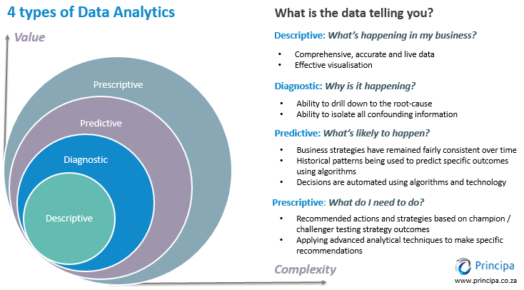
Types of Data Analytics
Intro to IoT (Spring 2022)

Slide 14
Types of Analysis
Two types are
Qualitative Analysis: Deals with analysis of data that is categorical in nature based on some properties or attributes
Quantitative Analysis: Refers to analysis of data based on computable values
Intro to IoT (Spring 2022)

Slide 15
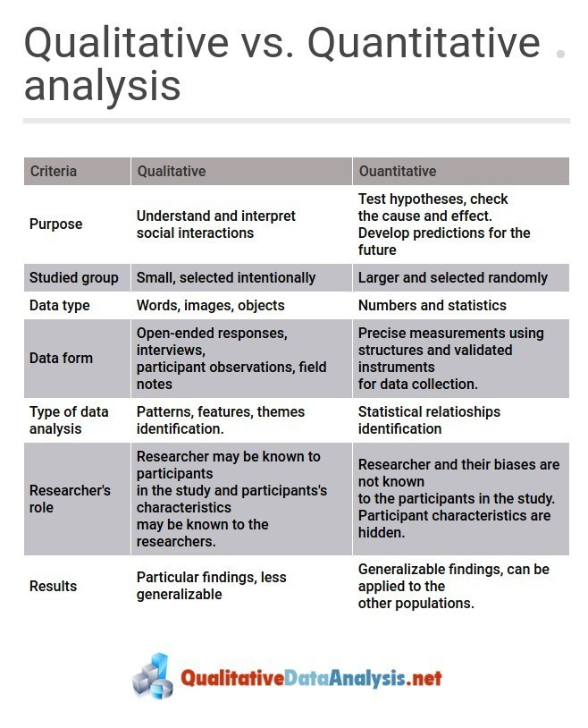
Types of Analysis
Intro to IoT (Spring 2022)

Slide 16
Quantitative Analysis
Involves descriptive statistics such as mean, median, standard deviation
Following are often involved with quantitative analysis:
Statistical models
Analysis of variance
Data dispersion
Analysis of relationships between variables
Contingence and correlation
Regression Analysis
Statistical significance
Precision
Error limits
Intro to IoT (Spring 2022)

Slide 17
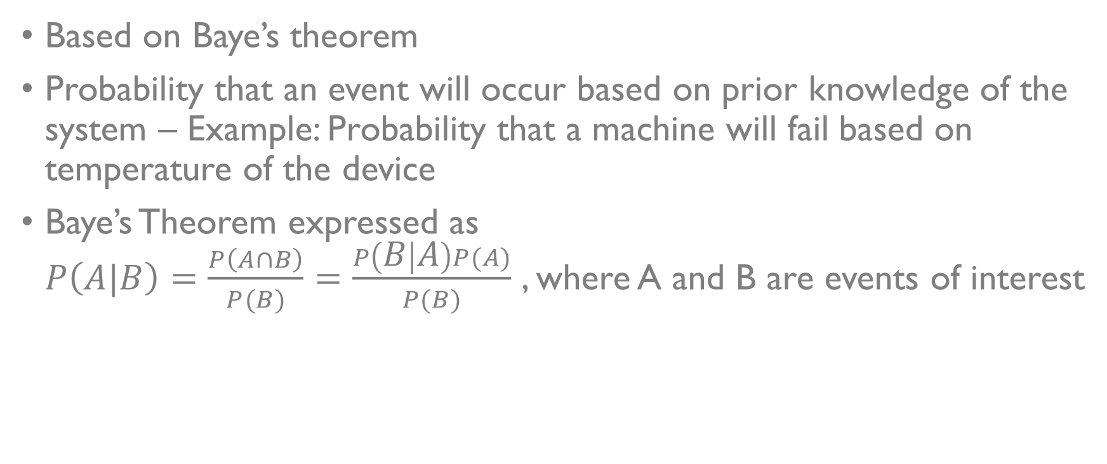
Bayesian Models
Based on Baye’s theorem
Probability that an event will occur based on prior knowledge of the system – Example: Probability that a machine will fail based on temperature of the device
Baye’s Theorem expressed as $P\left(A|B\right)=\frac{P\left(A∩B\right)}{P(B)}=\frac{P\left(B | A\right)P(A)}{P(B)}$ , where A and B are events of interest
Intro to IoT (Spring 2022)

Slide 18
Bayesian Network Model
Intro to IoT (Spring 2022)

Slide 19
Basic Data Analytics in IoT
Preprocessing: Filter events of little interest, feature extraction, segmentation, data transformation, adding attributes
Alerting: Inspect and alert if data exceeds boundary condition
Windowing: A sliding window of events is created – Time based or Length based Example: No. of spikes in any parameter in the last 1 hour
Joins: Combines multiple data streams into a new single stream
Errors: Detecting missing data, garbled data, and data that is out of sequence
Intro to IoT (Spring 2022)

Slide 20
Basic Data Analytics in IoT
Temporal events and patterns: Sequence of events constituting a pattern of interest
Trends Useful for predictive maintenance. A rule to detect an event based on time-correlated series data
Intro to IoT (Spring 2022)

Slide 21
Analytics in the Cloud
Rules Engines: Define an action and produce an outcome based on events
Stream Processing: A graph-based data processing architecture where nodes represent operators on data input and events sent to other operators. Graph can be replicated and executed in parallel
Complex Event Processing: Often used for pattern detection. Many events reduced and transformed into higher-level events → more abstract than raw sensor data
Intro to IoT (Spring 2022)

Slide 22
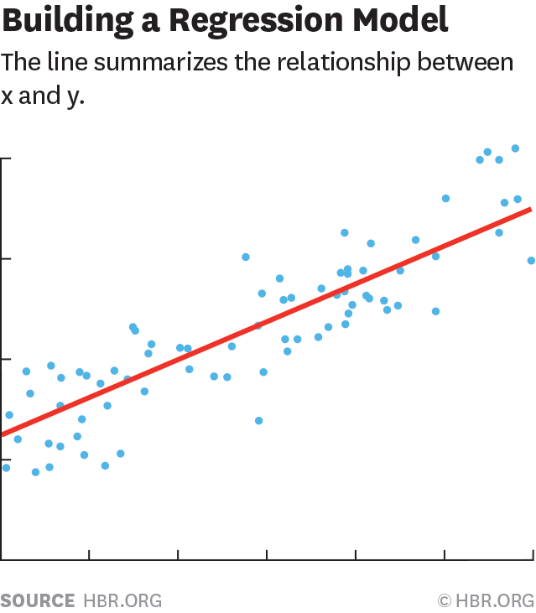
Regression Analysis
A powerful statistical method that allows to examine the relationship between two or more variables of interest
Focuses on the influence of one or more independent variables on a dependent variable
Intro to IoT (Spring 2022)

Slide 23
Thank You!!

